Slide 1
Starbucks
Data Analysis
Spring 2024 Datathon
Vick Maturu

Slide 2
Table of contents
01
02
03
04
05
06
Data Cleaning
Plan
Procedure
Final Result
Analysis
Done

Slide 3
01
Data prep

Slide 4
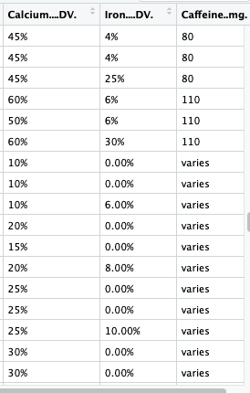
Why I had to Clean the Data
From the 2 datasets that were given, I chose the: Starbucks Data set.
Looking through the data, I realized that there were data points that altered the way the visualizations and calculations were done. Therefore I created subsets to remove those anomalies, so I could work with a clean set of data

Slide 5
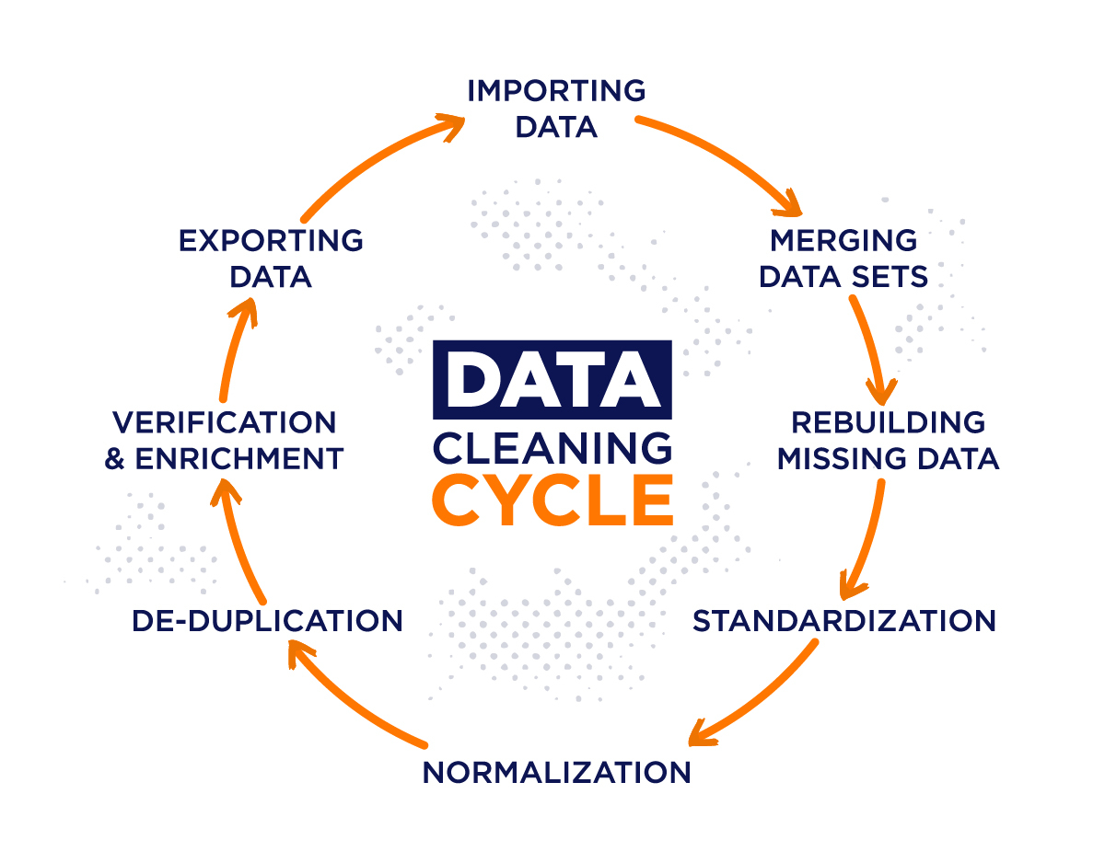
Significance of Data Cleansing
Data Cleansing is a vital part of any Data scientist’s career. The reasons it is important are:
Better Accuracy & Reliability
Improved Model Performance (If working with ML/AI)
Outlier Anomaly
Time and Cost Efficiency

Slide 6
Plan
After brainstorming and doing some research online, I decided that I wanted to analyze the relationships between the Calories, Sodium, Protein, and Sugars within all of the drinks.
I decided to create an Interactive Web Application using R Shiny, which would make it very simple for viewing and statistical analysis.
The plots I wanted to work with the most were: Scatterplots, Histogram. As these visualizations allowed me to perform regression analysis and understand the correlations between the nutrients of the drinks.

Slide 7

Web App

Slide 8

Libraries Used
Using the “Shiny” library allows you to have access to all the functions within R Shiny. Some functions include: Drop Menus, Radio Buttons, Check Boxes, and other web development tools.
Using the “Janitor” library allowed for simple data cleansing.
The Libraries of “Tidyverse” and “ggplot” allow you to create various visuals and graphs.

Slide 9
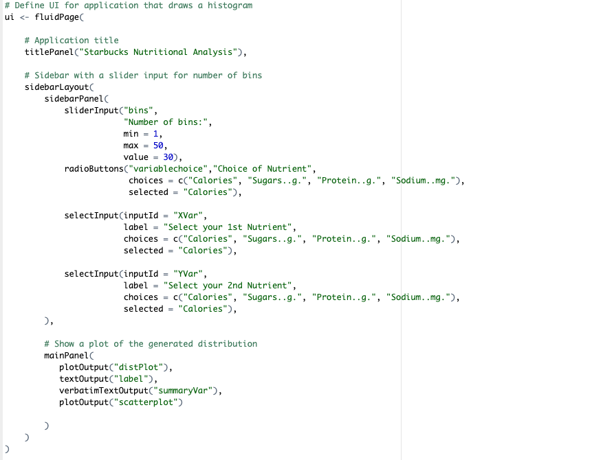
User Interface
Functions Used:
Sliders
Radio Buttons
Check boxes
Drop down menus

Slide 10
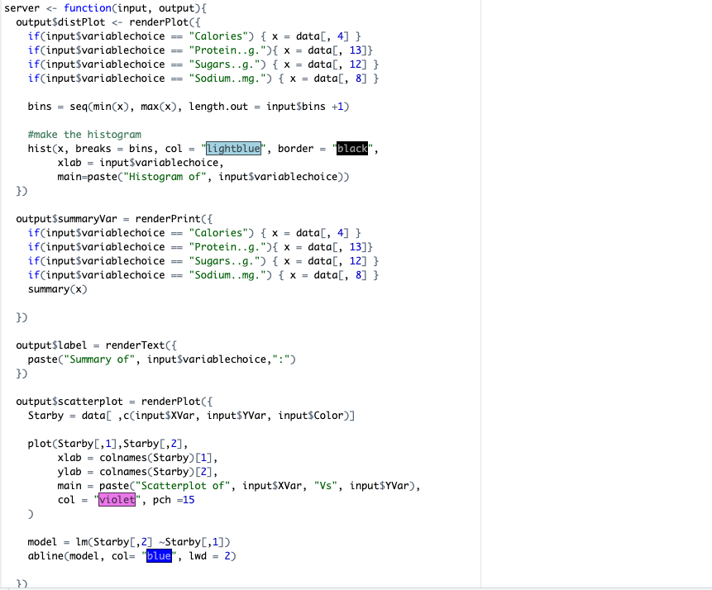
Back End Development

Slide 11
Statistical Analysis

Slide 12
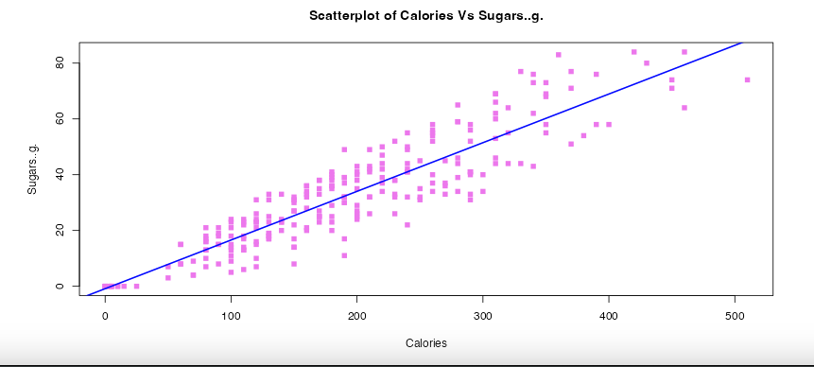

Calories vs Sugar
We all know that Sugar is in almost every drink, and it plays a huge role in our well being.
Hypothesis: Sugar content increases as Calories increase.
Conclusion: We notice a strong positive correlation between Calorie content and Sugar Content. As the caloric content is increasing, we see the sugar content rise as well. Most of the data lies towards the middle of the cluster.

Slide 13
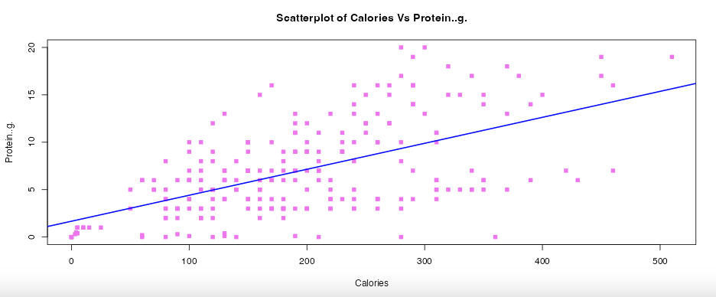
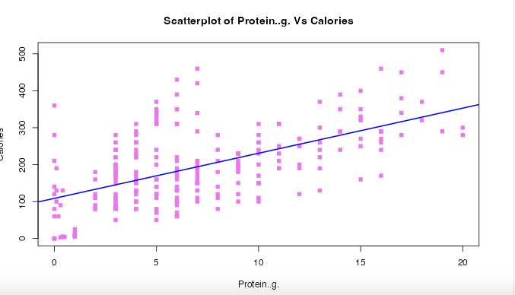
Calories vs Protein
Protein intake is vital component for our well being, so consuming protein rich items is necessary.
Hypothesis: Starbucks Drinks regardless of how many calories, will have very little protein.
Here we notice a moderate positive correlation between Calories and Protein. Hence I was proven wrong.
Majority of the data tells us that the starbucks drinks with the most protein lies towards the beginning and middle of the data set.
Even if we flip the axes, we still notice that increases in protein signify higher caloric content, meaning the heavier drinks are more protein rich.

Slide 14
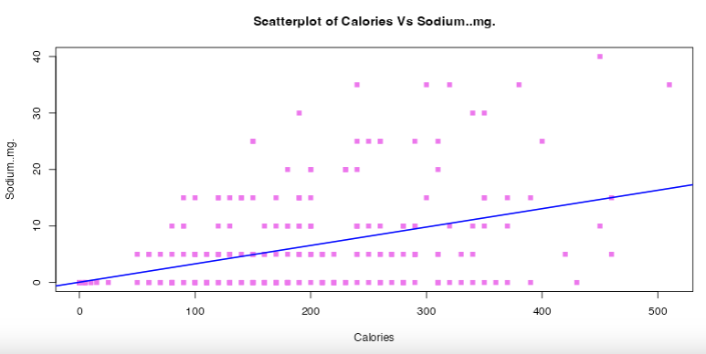
Calories vs Sodium
The average person needs approximately 2,300 mg of sodium per day.
Hypothesis: Starbucks Drinks regardless of how many calories, will have very little sodium.
Here we notice a low positive correlation between Calories and Sodium. Hence I was right!
We notice that even though the calories increase, the sodium levels are moderately low.
With most of the data lying towards the bottom and the middle, it’s safe to say that the drinks in the middle of the dataset have a high variability of sodium content.

Slide 15
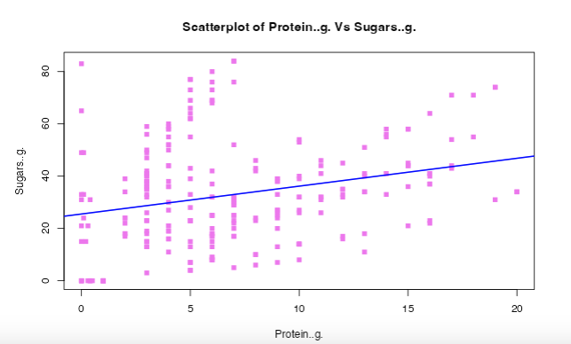
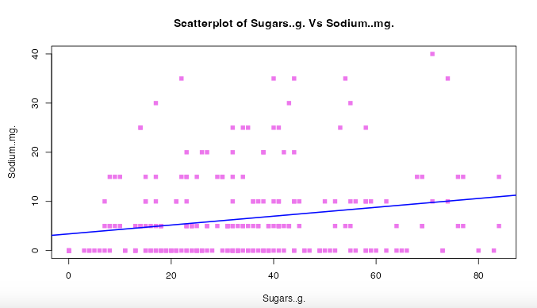
Misc Analysis
I also wanted to study the correlation between Sugar vs Sodium and Protein vs Sugar
Protein and Sugar have a mixed correlation, as Protein increases, the sugar content does too. This indicated that the protein rich drinks are most likely the most sugary.
Sugar and Sodium have weak relationship, as even though sugar content increases, sodium levels are low. Indicating that Starbucks drinks are low in sodium.

Slide 16
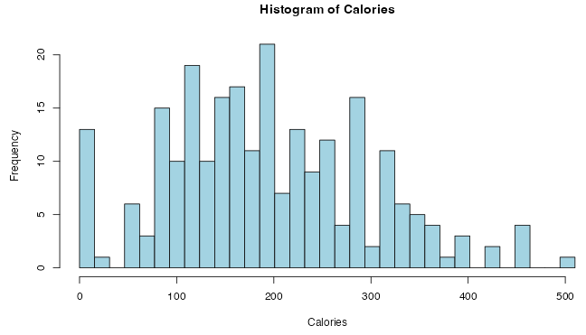
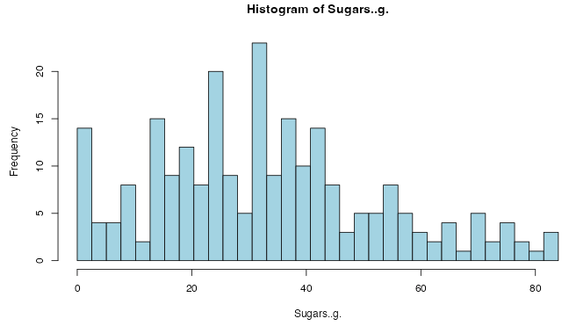
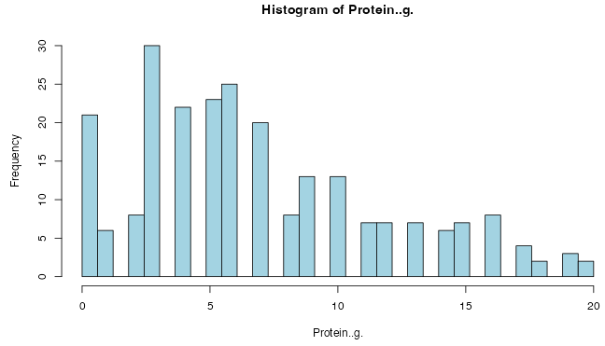
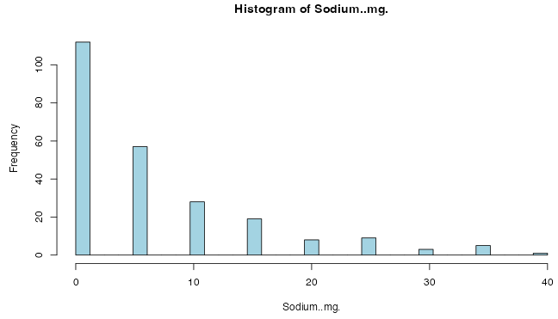
Nutrient Distribution
Normal dist, but slight skewness to the right. Most drinks lie from 100-300 Cal
Normal dist, but slight skewness to the right. Variety distribution of sugar in drinks.
Skewed right, Less frequency of protein rich drinks, & high frequency of protein less drinks
Skewed right, sodium content is overall very low,

Slide 17
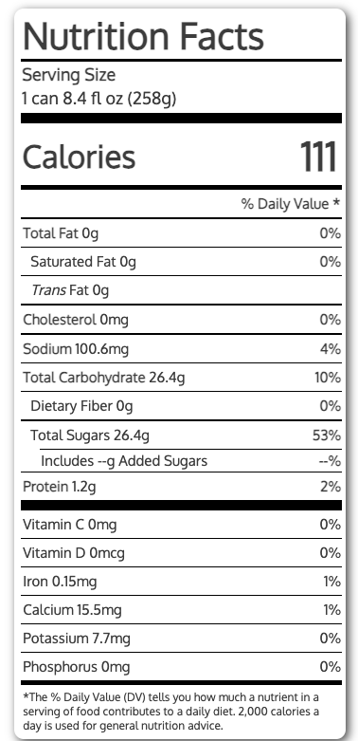
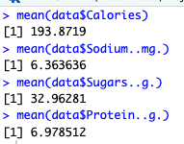
Red Bull vs Starbucks
Both companies are Caffeine Giants, but I want to prove see who is healthier.
Starbucks | Facts | RedBull
193.87 Cal | Calories | 111 Cal
32.96281g | Sugars | 26.4g
6.9785 mg | Protein | 1200mg
6.3636 mg | Sodium | 100.6mg

